Slide 1
Splufic Python Training
Welcome to the instructor-led Training for week one day one

Slide 2
Our Aim
Teach learners to design, develop and test software components and systems in a workplace environment, working as a team member, while contributing to the workflow for the finished product and leading to employment in a range of sectors.

Slide 3
What is Python?
Python is a very versatile programming language. In this Python training course, you'll learn how to program in Python.
Python also has a rich library making it possible to build sophisticated applications using relatively simple-looking code. For these reasons, Python has become a popular application development language and also the preferred “first” programming language.

Slide 4
Main Features
Python is a general-purpose language that was specifically designed to make programs very readable.
Easy to code ( read and write )
Easy for code documentation
It is free and open source
It is an object oriented language
It is a high level language
Has support for Graphical User Interface GUI
Developed in the late 1980s by Dutch programmer Guido van Rossum.

Slide 5
What Can Python Do?
Web Development
Scientific and Numeric Computing
Function Decorators Allow Enhanced Functionality
Machine Learning (ML)
Embedded Systems Development
Desktop Application Development
Browser Web Application Automation

Slide 6
Learning Goals?
write high-quality and efficient python code
Understand how to write tests for your Python code
apply for real-time programming positions
solve 15+ real-world problems.
make yourself marketable for entry-intermediate level programming positions
contribute to open source projects
Gain extensive knowledge of Git/Github

Slide 7
Contents (at a glance):
Functions/Modules
Arrays, Lists, Dictionaries and Sets
Strings, Lists and Tuples
Flow control
File Input/Output
exceptions handling
Object Oriented Programming and Design (OOPD)
Python Standard Library (time and date)
Web Design (flask)
GUI Development (tkinter)
version control with Git/GitHub

Slide 8
What is computer Science?
Computer science is the study of computation and information.
Computation is any type of calculation that includes both arithmetic and non-arithmetic steps and which follows a well defined model
Information is processed data

Slide 9
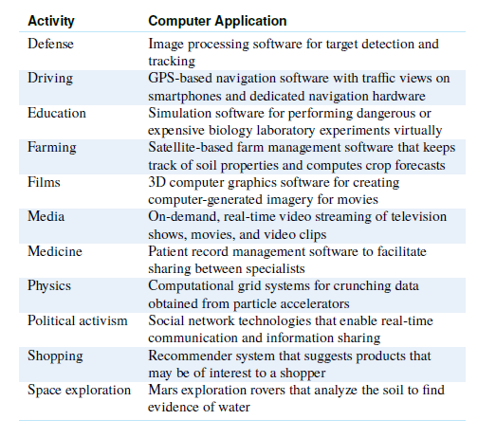
Application Areas Of Computer Science

Slide 10
Tools Used in Developing Applications
Logic and Mathematics
Computers
Software, IDEs and Compilers
Test editors: sublime text

Slide 11
Definition of Basic Terms
Computational Thinking
Model
Algorithm
Data

Slide 12
Computational Thinking
Computational thinking is a term used to describe the intellectual approach through which natural or artificial processes or tasks are understood and described as computational processes. This skill is probably the most important one you will develop in your training as a computer scientist.
Think like a computer!

Slide 13
Model
In general, a model is an informative representation of an object, person or system.
It contains data or information about itself or the environment that has an input, and an output
In describing a model, there must be clear definition of its data in terms of
shape (1D, 2D or 3D),
size,

Slide 14
Data
a piece of information.
This information may be in the form of text documents, images, audio clips, software programs, or other types of data.
It may also mean something given
It has a type and it varies (variables)
It has shape and size

Slide 15
Algorithm
Is a process or set of rules to be followed in calculations or other problem-solving operations, especially by a computer.
It determines the behaviour and operation of models
We start the development of the algorithm by clearly specifying the input data (i.e., the information we start with) and the output data (i.e., the information we desire to obtain)

Slide 16
Data Types
The data type refers to the range of values data (variables) can have (e.g., integer, non-integer number, sequence of characters, or list of other values) and also to the operations that can be performed on the data.

Slide 17
Python Syntax
A set of rules which defines how a Python program will be written
each line in a Python script is a statement
It is case sensitive
Comments Are Marked by #
End-of-Line Terminates a Statement
Use ‘\’ to write multiline statements
Indentation: Whitespace Matters!
To write two separate executable statements in a single line, you should use a semicolon ;

Slide 18
Error
There is an error in a Python program is when a certain statement is not in accordance with the prescribed usage.

Slide 19
Syntax Error
The most common reason of an error in a Python program is when a certain statement is not in accordance with the prescribed usage. Such an error is called a syntax error. The Python interpreter immediately reports it, usually along with the reason.

Slide 20
Semantic Error
It is user generated
It occurs when you make a mistake in the input data

Slide 21
Error Debugging
It is the process of removing error from python programs

Slide 22
Questions?

Slide 23
Assignment
Read about computer science at https://en.wikipedia.org/wiki/Computer_science
Read chapters one and two of the course textbook

